Slide 1
Wabash Capstone Project Notes 08
By: John Danison

Slide 2
What Did I Say I Would Do This Week?
Continue to support lab testing as requested.
Continue to develop data offloading software.

Slide 3
What I Have Done Over The Past Week
Performed lab testing on Kingpin assembly.
Added features to Wabash data offloading software.
Attended meetings and class.
Contributed to Capstone Poster.

Slide 4
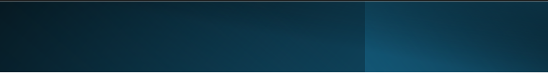
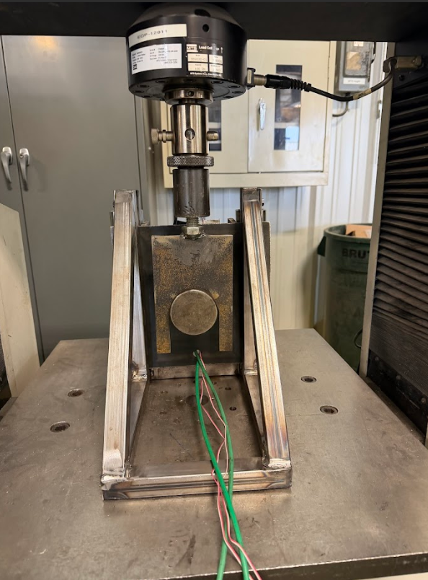
Wabash Lab Testing
Went to Wabash:
Attached system to their rig
Gathered data
Troubleshot issues
Showed offloading software

Slide 5
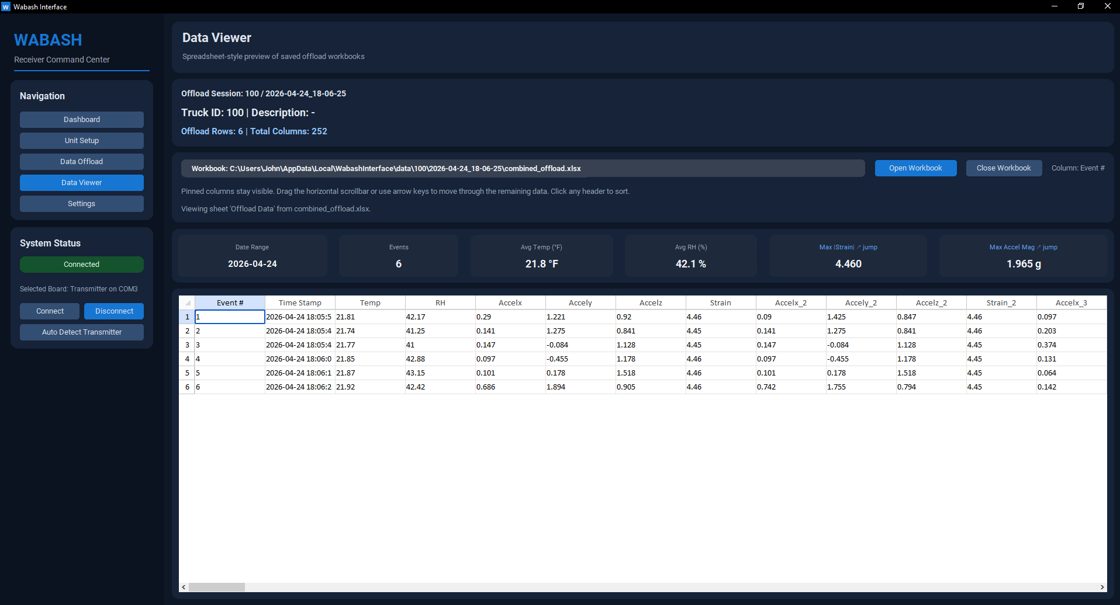
Wabash Software Updates
Software Changes:
Added data viewer screen
Fixed offloaded data configuration
Fixed LoRa fall back & Multiple Wi-Fi configuration setup

Slide 6
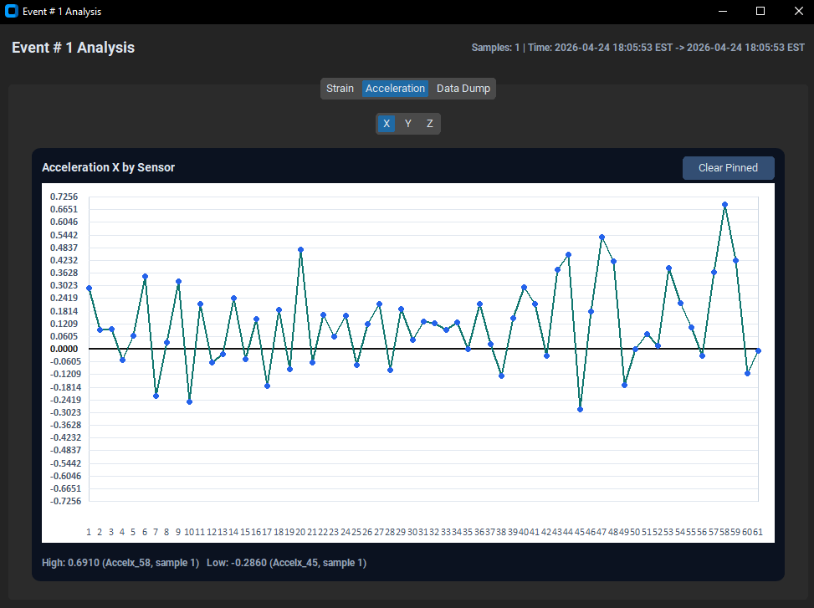
Wabash Software Updates
Software Changes:
Added data viewer screen
Fixed offloaded data configuration
Fixed LoRa fall back & Multiple Wi-Fi configuration setup

Slide 7
Did I Do What I Say I Would Do?
I feel that I accomplished everything that I said I would do over these past couple weeks.
The data offloading software is practically finished!
I attended all lectures, labs, and meetings w/ the client.

Slide 8
Plans For Upcoming Weeks
High Level
By EOW:
Continue to develop data offloading software.
Continue to show up to class.
Continue to support lab testing as requested by the team.
Continue to add client feature requests in data offloading software.
Send compiled .exe to Luke

